Slide 1
Engineering Drawing & Graphics
Engineering Drawing & CAD
Lecture 03 (continued)
Projection of Points
By
Umer Farooq
Mar, 2019

Slide 2
PROJECTIONS OF POINTS
GENERAL CONVENTIONS
  The actual point in space is annotated as an upper case letter.
  The front view is annotated as a lower case letter with a prime and the top view as a lower case letter without a prime, e.g., if the actual point is ‘A’ then its Front View is marked as a´ and its Top view is marked with a.
  The intersection of the two principal planes, i.e., the Horizontal Plane (H.P.) and the Vertical Plane (V.P.), is a straight line known as the reference line and shall be annotated as the xy line.

Slide 3
PROJECTIONS OF POINTS
  A point can be situated anywhere in the three dimensional space relative to the two planes of projection.
  The point can be either above, below or within the H.P.
  The point can be either in front of, behind or within the V.P.
  With Reference to H.P. With Reference to V.P.
  Above In Front
  Below Behind
  Within Within

Slide 4
With Reference to H.P. With Reference to V.P.
  Above In Front
  Below Behind
  Within Within
  Nine possible positions with respect to the two reference planes.
    Above the H.P. & In Front of the V.P. (1st Angle)
    Above the H.P. & Behind the V.P. (2nd Angle)
    Above the H.P. & Within the V.P. (Boundary of 1st and 2nd Angle)
    Below the H.P. & In Front of the V.P. (4th Angle)
    Below the H.P. & Behind the V.P. (3rd Angle)
    Below the H.P. & Within the V.P. (Boundary of 3rd and 4th Angle)
    Within the H.P. & In Front of the V.P. (Boundary of 1st and 4th Angle)
    Within the H.P. & Behind the V.P. (Boundary of 2nd and 4th Angle)
    Within the H.P. & Within the V.P. (In the Reference Line)

Slide 5
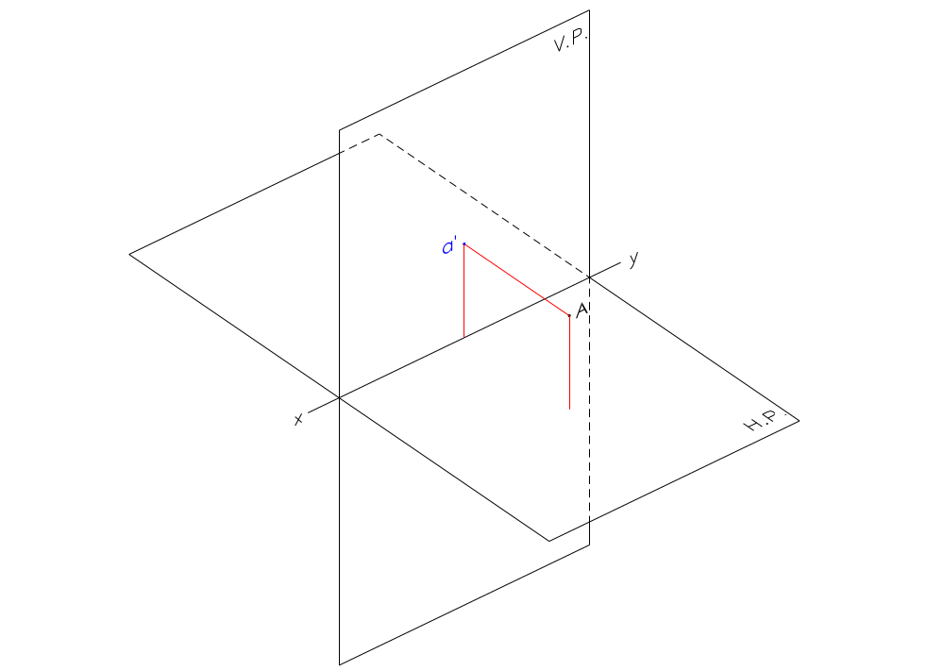
  Point Above the H.P. and In Front of the V.P.
    Front View is drawn Above the xy.

Slide 6
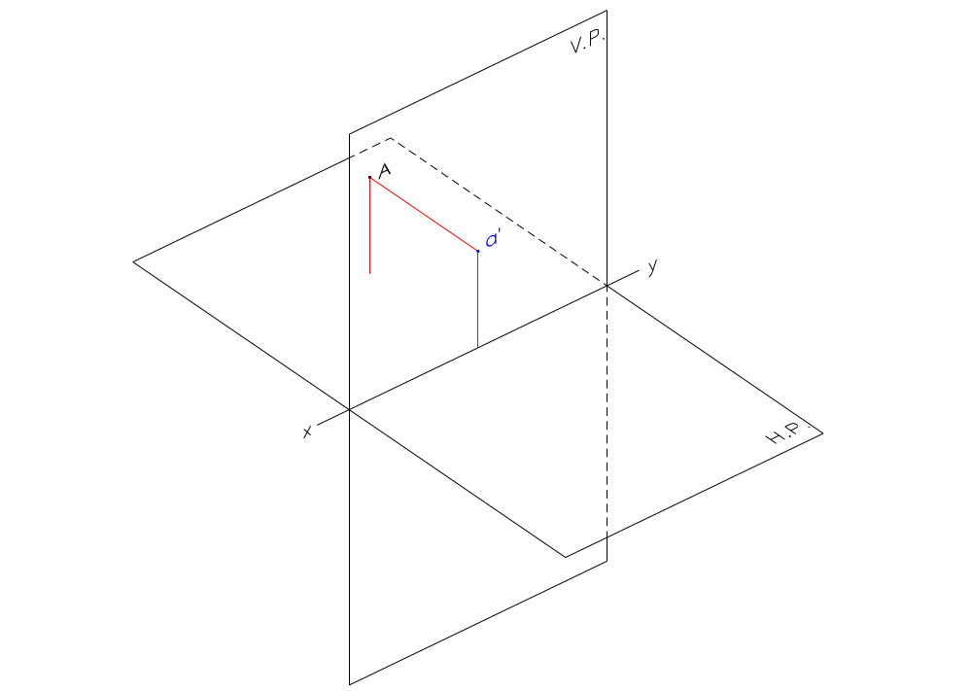
  Point Above the H.P. and Behind the V.P.
    Front View is drawn Above the xy.

Slide 7
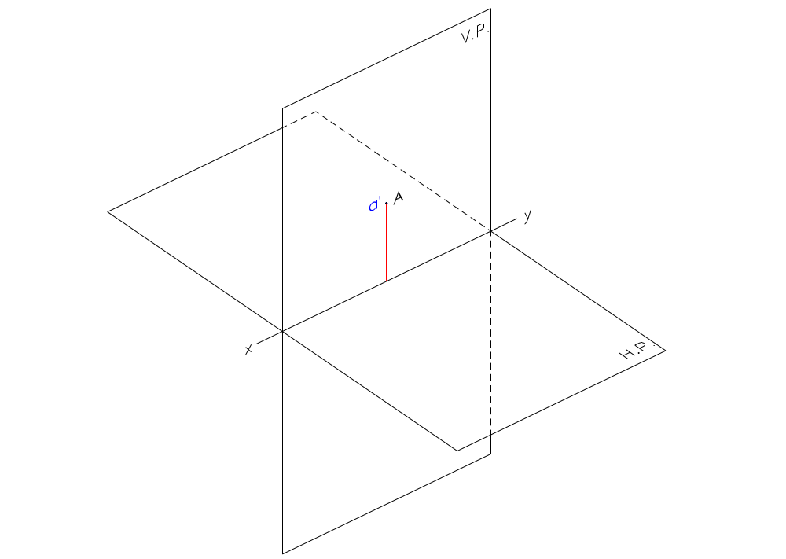
  Point Above the H.P. and Within the V.P.
    Front View is drawn Above the xy.

Slide 8
If a point is ABOVE the H.P.;
Its Front View is always ABOVE xy.

Slide 9
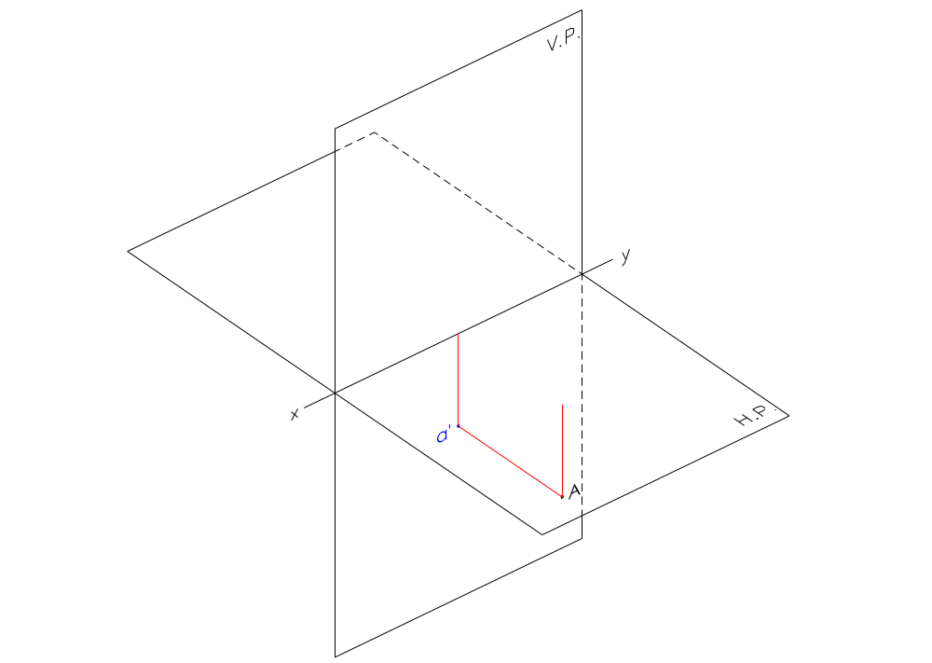
  Point Below the H.P. and In Front of the V.P.
    Front View is drawn Below the xy.

Slide 10
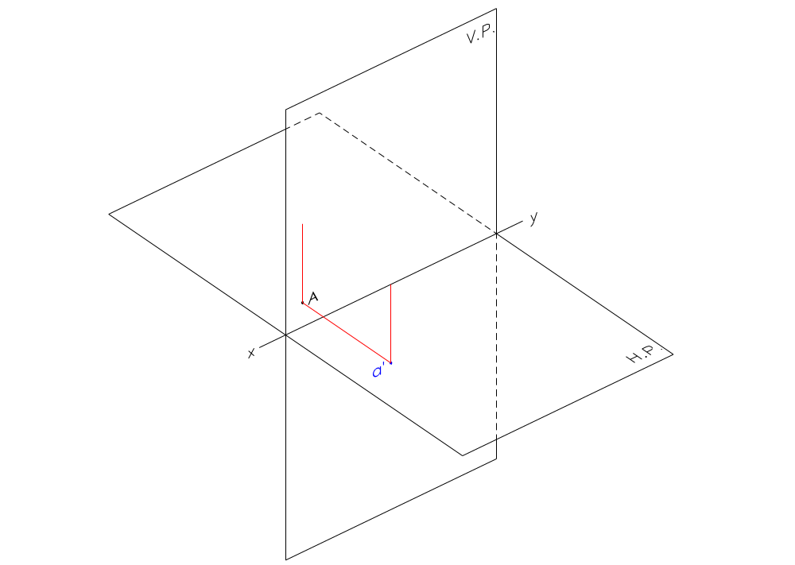
  Point Below the H.P. and Behind the V.P.
    Front View is drawn Below the xy.

Slide 11
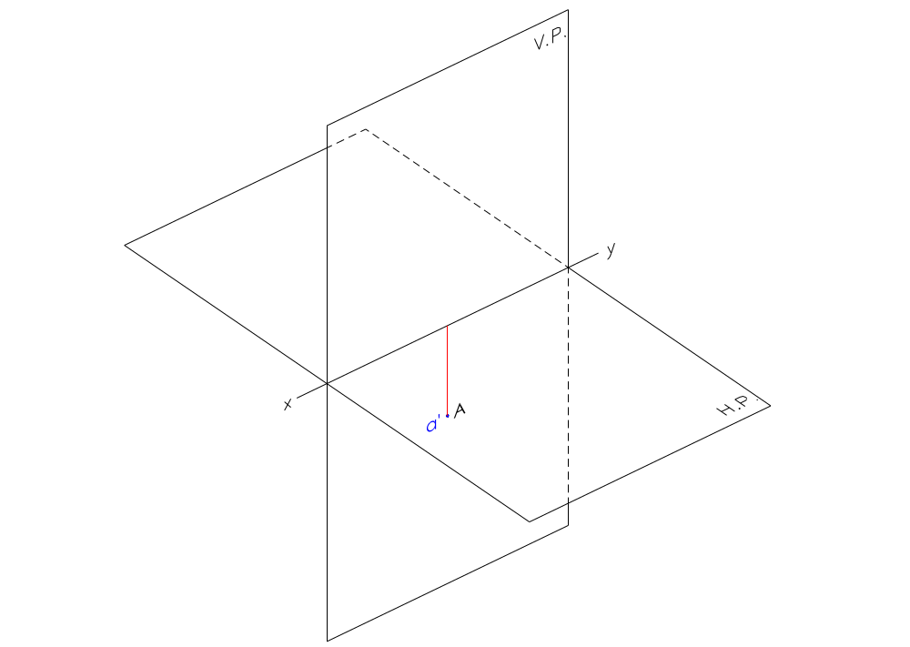
  Point Below the H.P. and Within the V.P.
    Front View is drawn Below the xy.

Slide 12
If a point is BELOW the H.P.;
Its Front View is always BELOW xy.

Slide 13
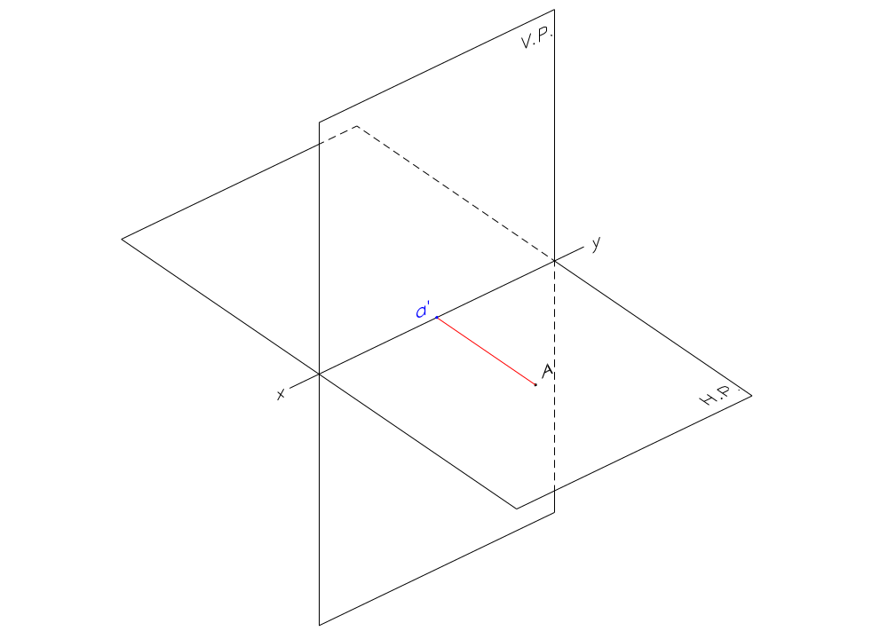
  Point Within the H.P. and In Front of the V.P.
    Front View is drawn In the xy.

Slide 14
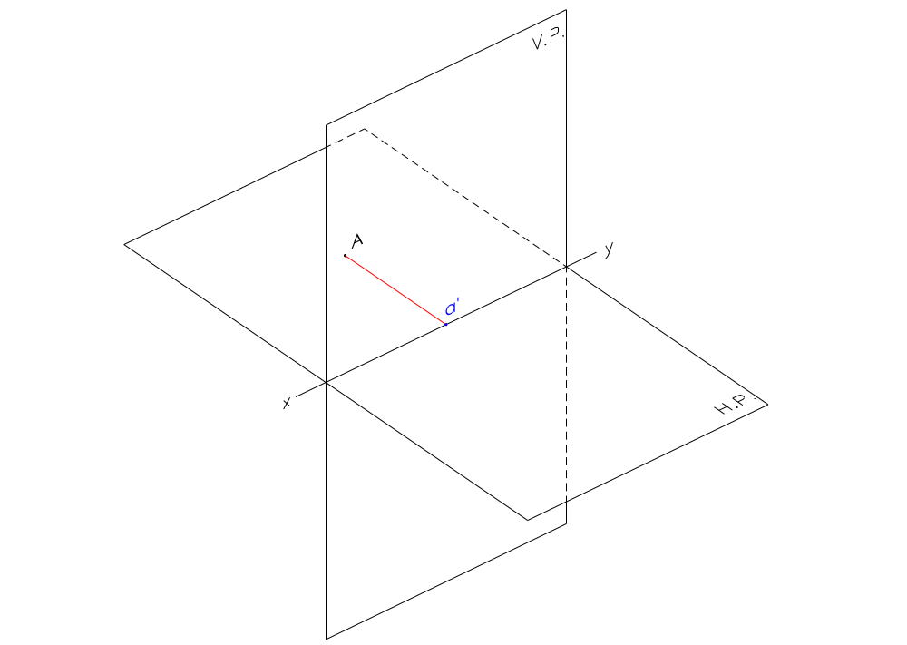
  Point Within the H.P. and Behind the V.P.
    Front View is drawn In the xy.

Slide 15
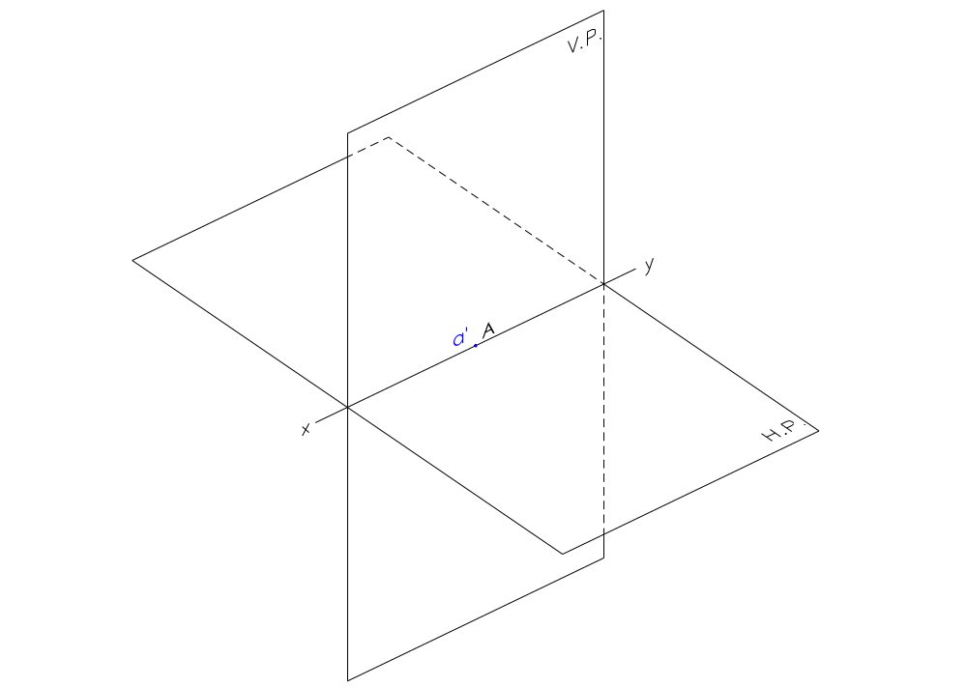
  Point Within the H.P. and Within the V.P.
    Front View is drawn In the xy.

Slide 16
If a point is WITHIN the H.P.;
Its Front View is always IN xy.

Slide 17
The position of the Front View of a point with respect to the xy line is dependent on its position with respect to the H.P.
The distance of the Front View of the point from the xy line is the same as the distance of the point from the H.P.

Slide 18
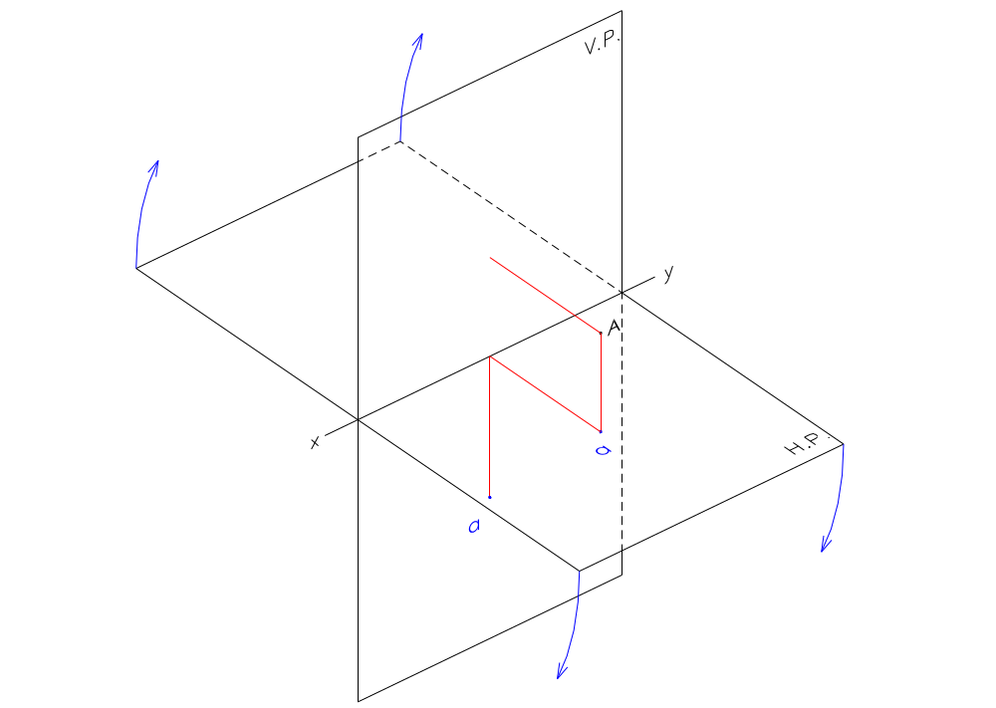
  Point In front of the V.P. and Above the H.P.
    Top View is drawn Below the xy.

Slide 19
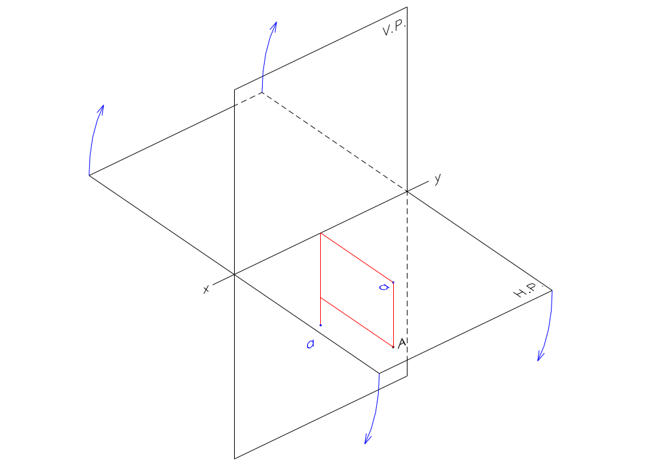
  Point In front of the V.P. and Below the H.P.
    Top View is drawn Below the xy.

Slide 20
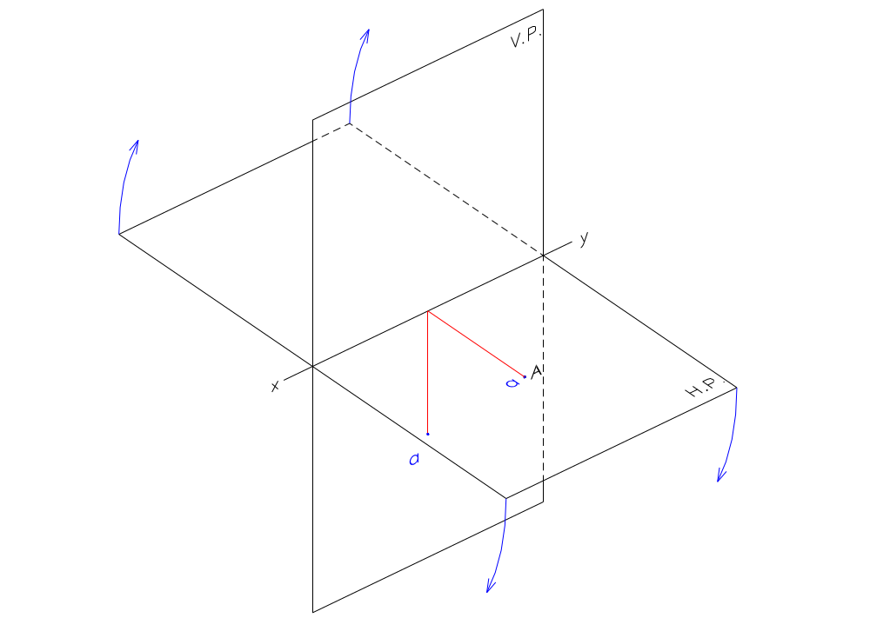
  Point In front of the V.P. and Within the H.P.
    Top View is drawn Below the xy.

Slide 21
If a point is IN FRONT of the V.P.;
Its Top View is always BELOW xy.

Slide 22
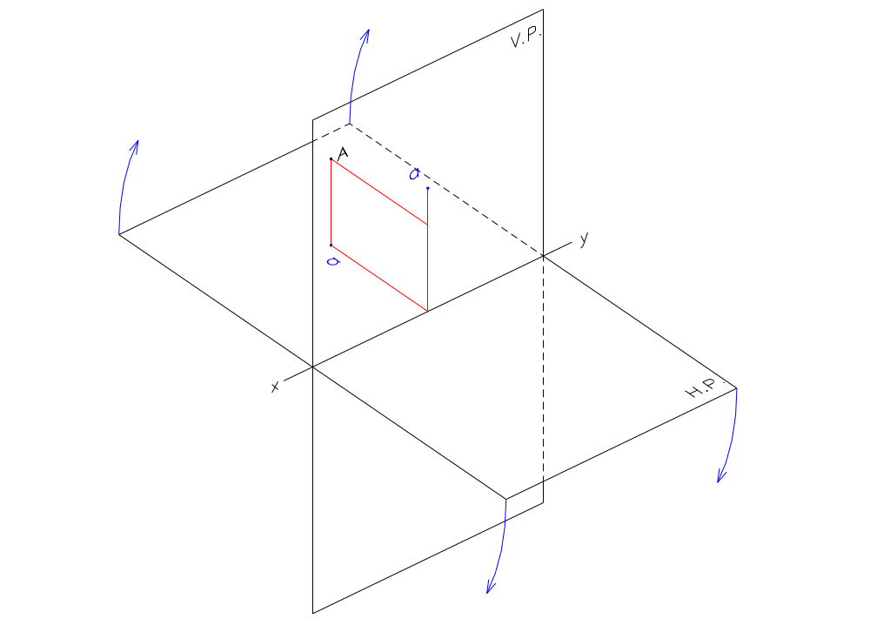
  Point Behind the V.P. and Above the H.P.
    Top View is drawn Above the xy.

Slide 23
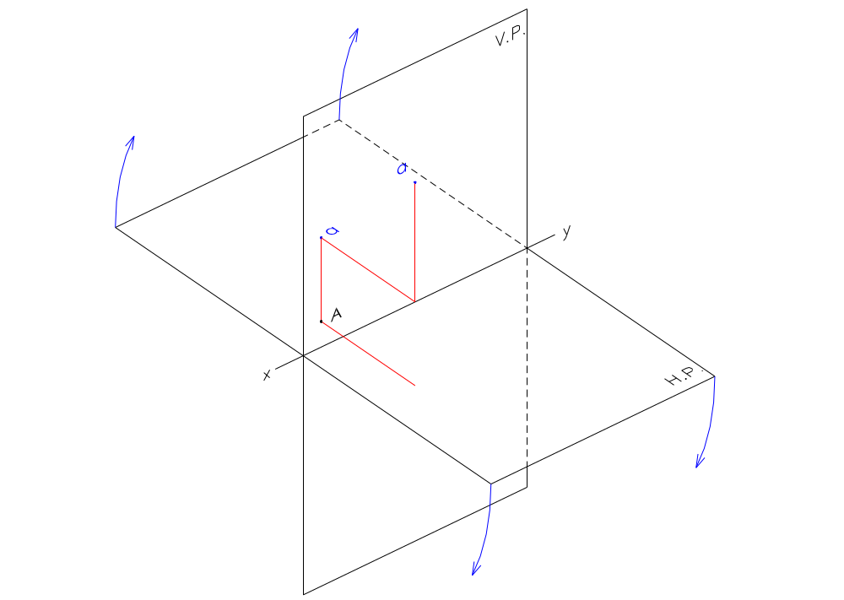
  Point Behind the V.P. and Below the H.P.
    Top View is drawn Above the xy.

Slide 24
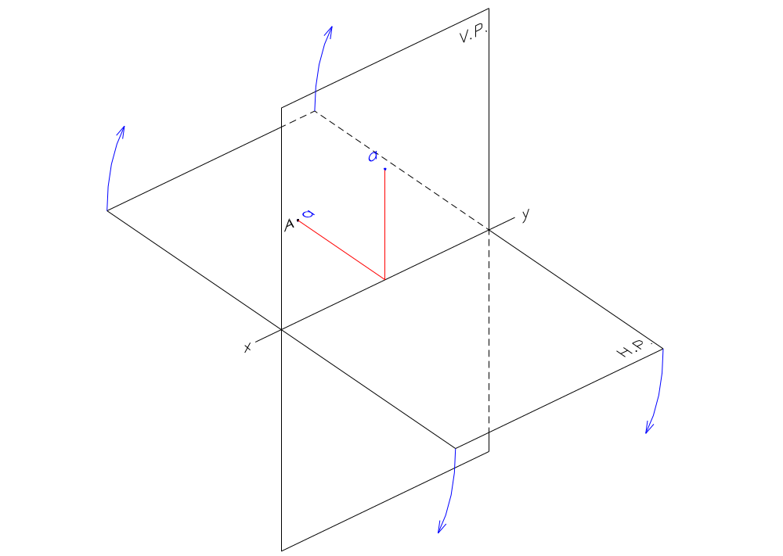
  Point Behind the V.P. and Within the H.P.
    Top View is drawn Above the xy.

Slide 25
If a point is BEHIND the V.P.;
Its Top View is always ABOVE xy.

Slide 26
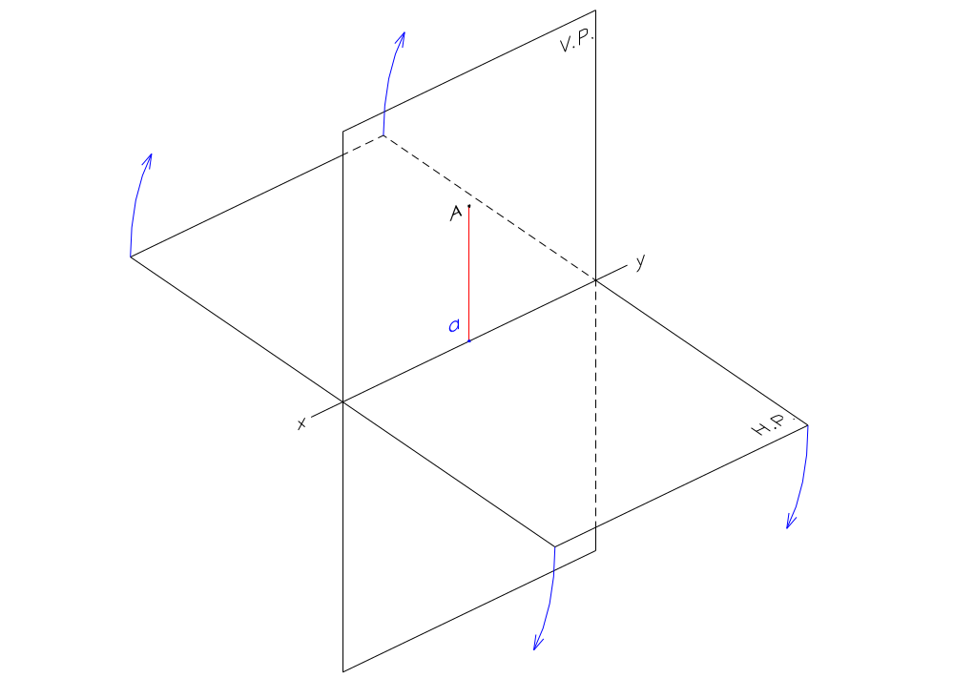
  Point Within the V.P. and Above the H.P.
    Top View is drawn In the xy.

Slide 27
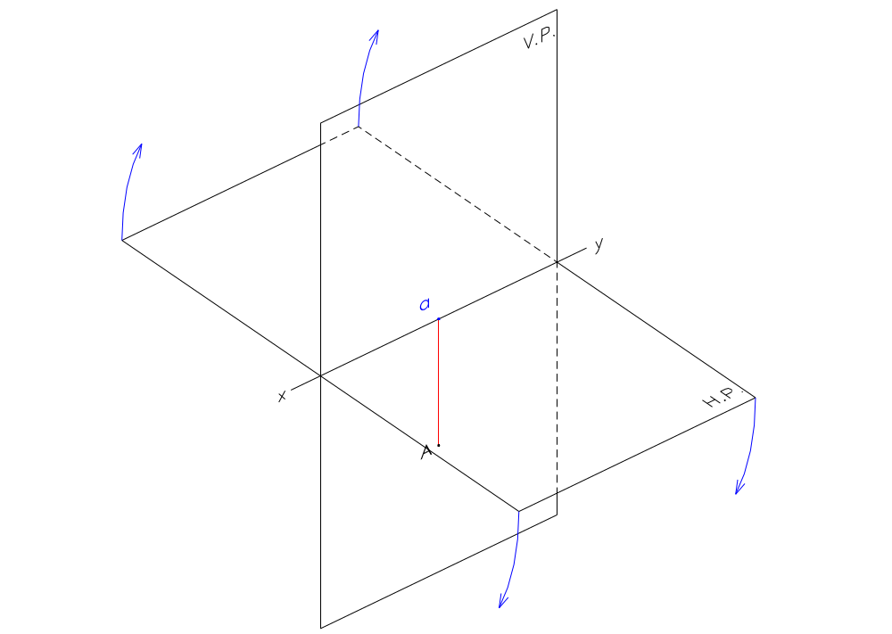
  Point Within the V.P. and Below the H.P.
    Top View is drawn In the xy.

Slide 28
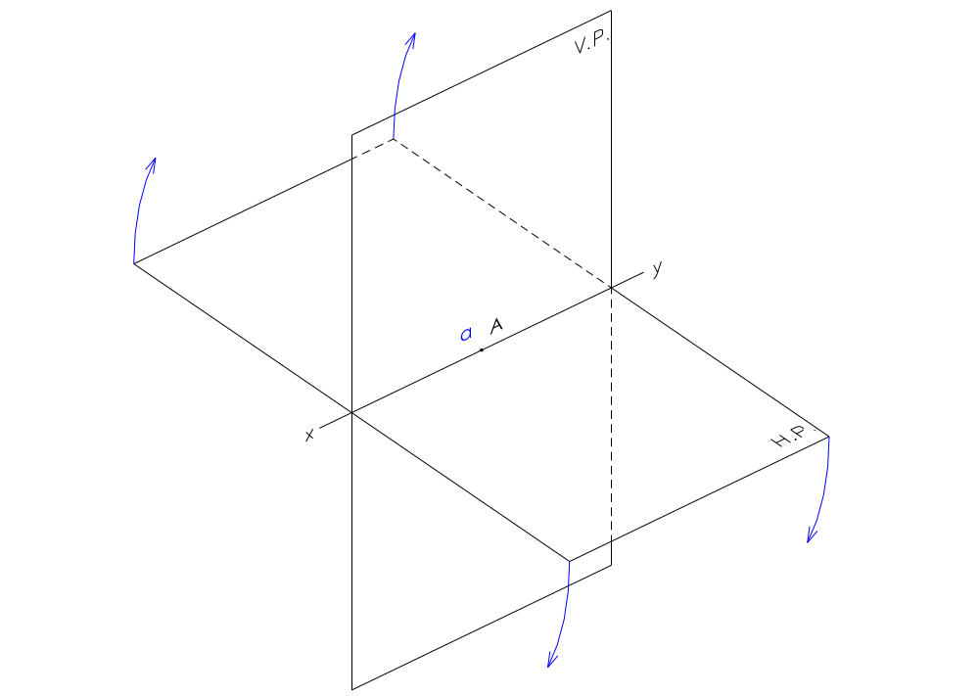
  Point Within the V.P. and Within the H.P.
    Top View is drawn In the xy.

Slide 29
If a point is WITHIN the V.P.;
Its Top View is always IN xy.

Slide 30
The position of the Top View of a point with respect to the xy line is dependent on its position with respect to the V.P. only.
The distance of the Top View of the point from the xy line is the same as the distance of the point from the V.P.

Slide 31
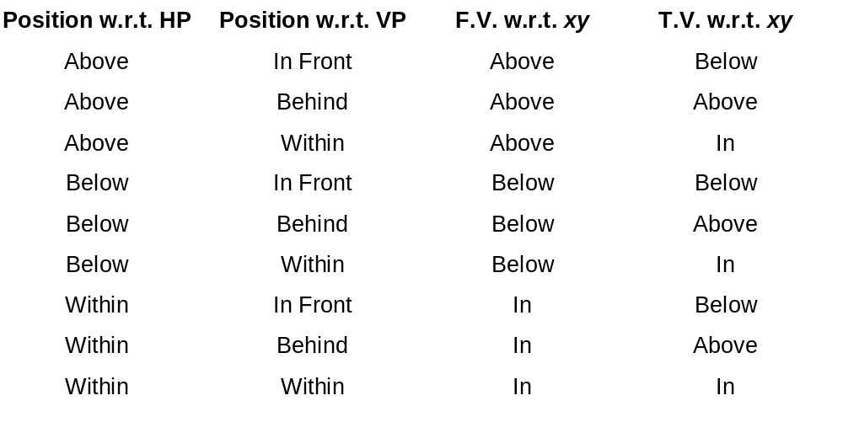

Slide 32
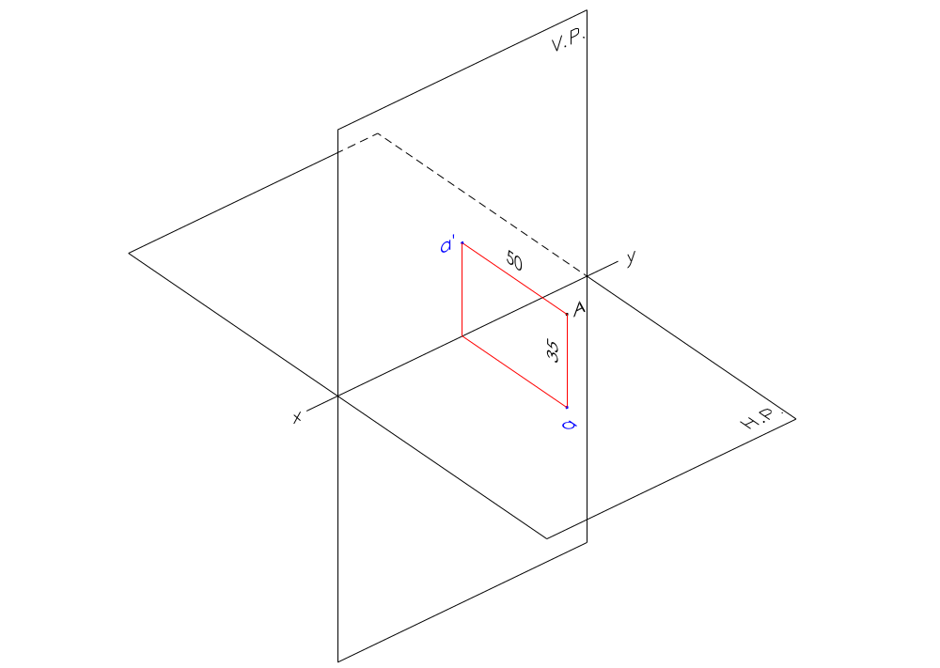
Example:
  A point ‘A’ is 35 mm above the H.P. and 50 mm in front of the V.P.

Slide 33
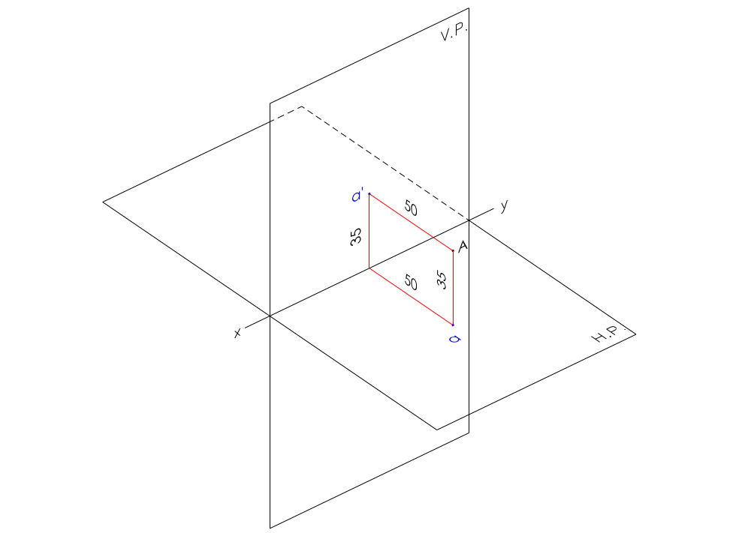
Example:
  A point ‘A’ is 35 mm above the H.P. and 50 mm in front of the V.P.

Slide 34
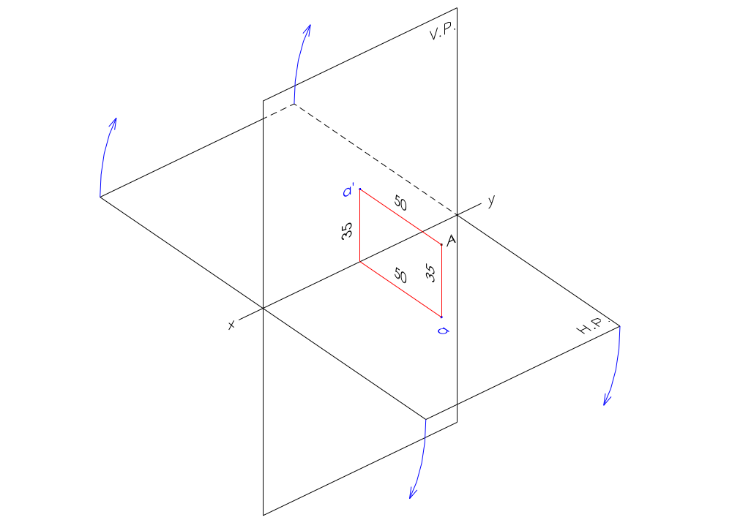
Example:
  A point ‘A’ is 35 mm above the H.P. and 50 mm in front of the V.P.

Slide 35
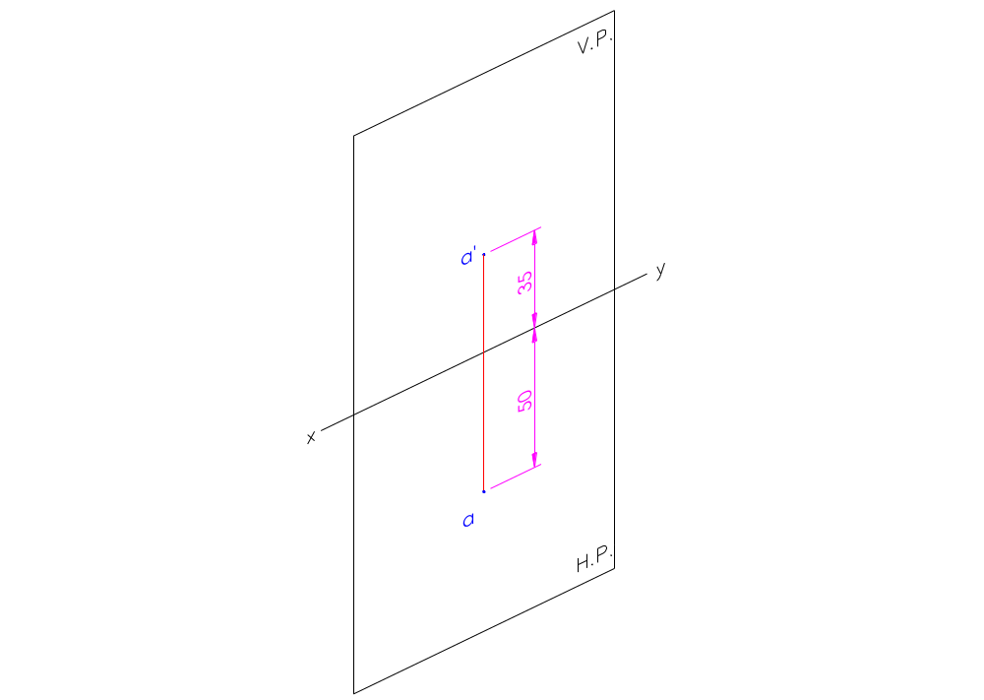
Example:
  A point ‘A’ is 35 mm above the H.P. and 50 mm in front of the V.P.

Slide 36
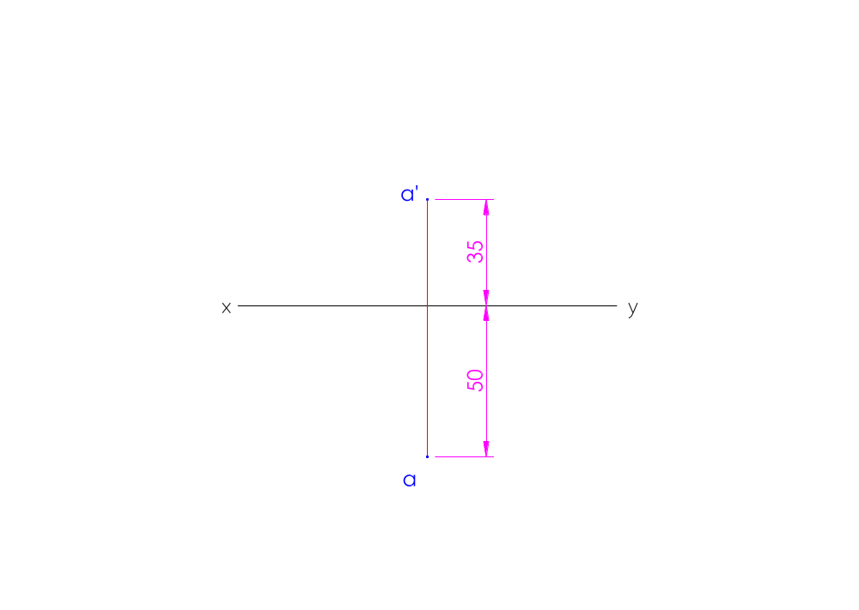
Example:
  A point ‘A’ is 35 mm above the H.P. and 50 mm in front of the V.P.

Slide 37
Practice problems
Exercise # 9
Page # 193 Chapter 9 N. D. Butt 52 Edition
Problems # 1, 2, 3, 4, 5, 6, 7, 8, 9, 10

